Slide 1
IBM APPLIED DATA SCIENCE CAPSTONE PRESENTATION
By Salman Lakhani

Slide 2
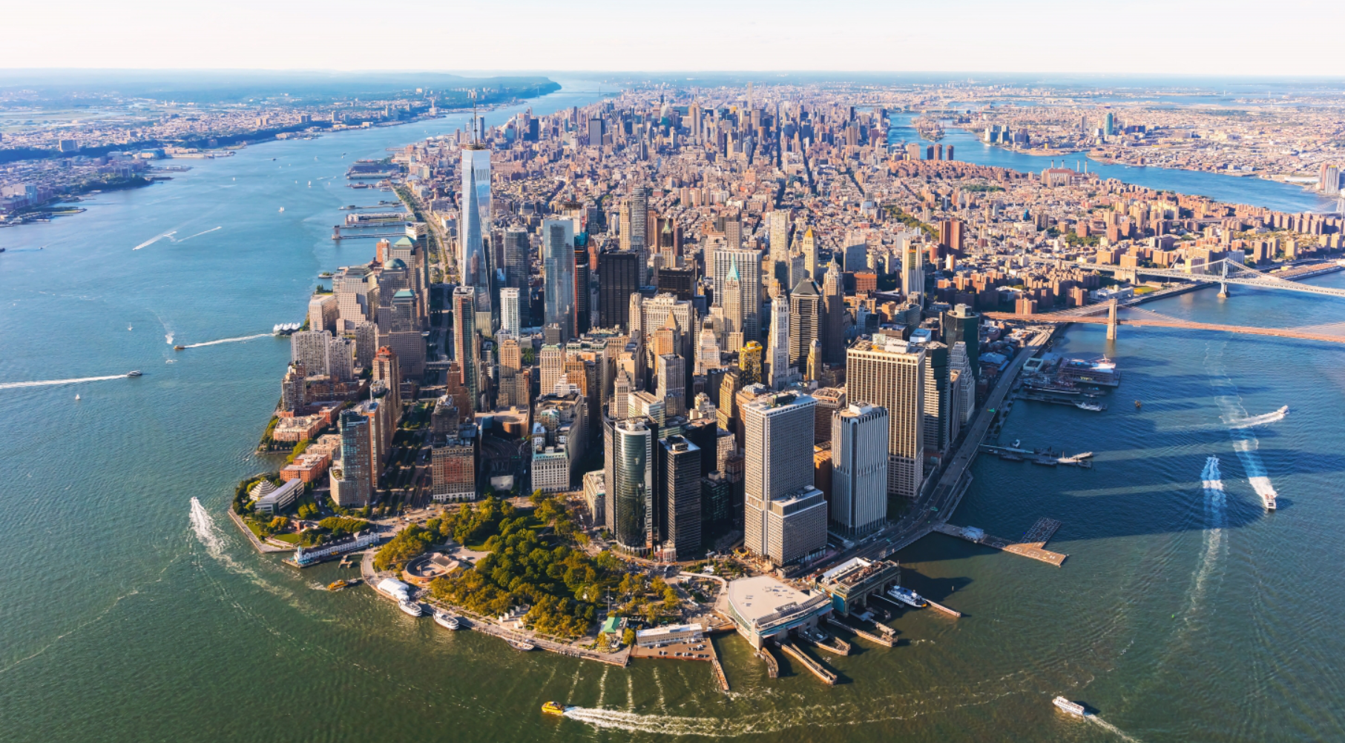
INTRODUCTION
The city was founded by Dutch Republic in 1624 on Lower Manhattan, orginally was called New Amsterdam in 1626. The city of New York is one of the most recognized cities in the world. All types of people are attracted to come to NYC. NYC is described as the cultural, financial, and media capital of the world. It has an estimated population of 8,398,748 spread around 302.6 square miles. It also impacts other areas such as:
1. Commerce
2. Entertainment
3. Research
4. Technology
5. Education
6. Politics
7. Tourism
8. Art
9. Fashion
10. Sports
It boosts a GDP of $1.9 Trillion dollars and if it was a state by itself, it would be considered 12th highest GDP. New York boosts highest number of billionaries in the world. The city has great amount of tourist attractions, which is great for businesses.

Slide 3
Business Problem
SAH Consulting has been hired to locate office area for manufacturing headquarters for a client HAL Manufacturing Group. The client is looking for an area that has good eateries to take clients too and keep their employee's happy. They want to present their high net worth clients with entertainment options in close vicinity to the office. The ability to have multiple different cuisine nearby is ideal for our client, since their business operations are around the world and has large influx of different ethnicities in their business.
To summarize what the client is looking for:
Great restaurant Variety
Diversity
Entertainment spots

Slide 4
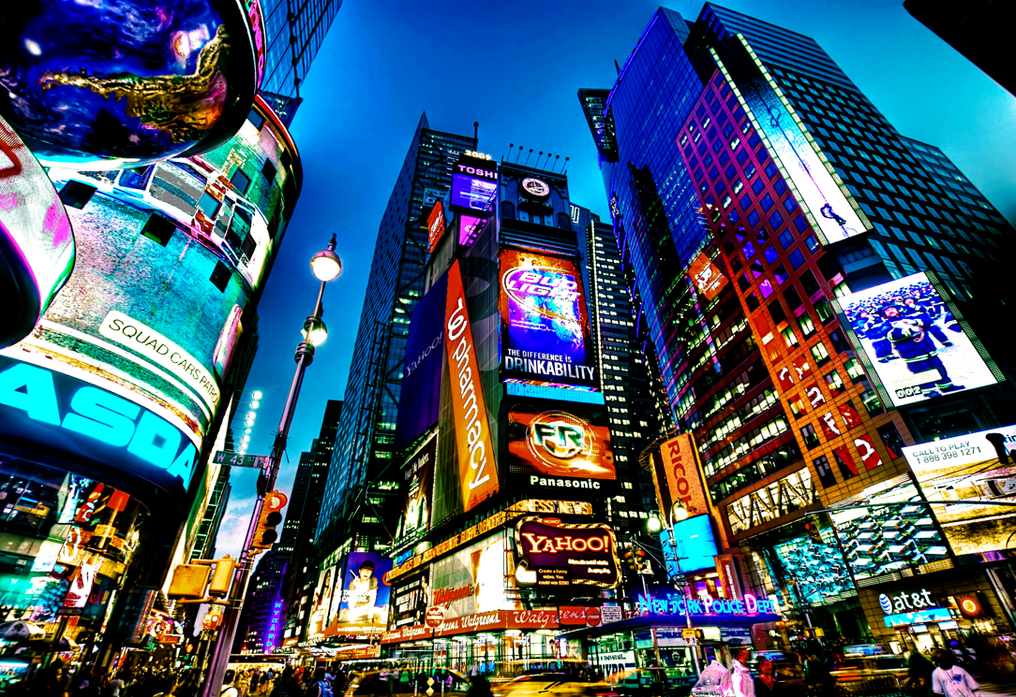
Facts about New York City
More than 800 languages are spoken in New York.
Brooklyn Bridge is older than tower bridge in London.
The average rent for a one bedroom in Manhattan is $3400 USD.
More than $380,000 millionaires in the city.
NYC is made up of five boroughs: Manhattan, the Bronx, Queens, Brooklyn, and Staten Island.
NYC is the largest city in the United States.
New York gets 15 times as much snow as the South Pole.
Current mayor is Bill de Blasio

Slide 5
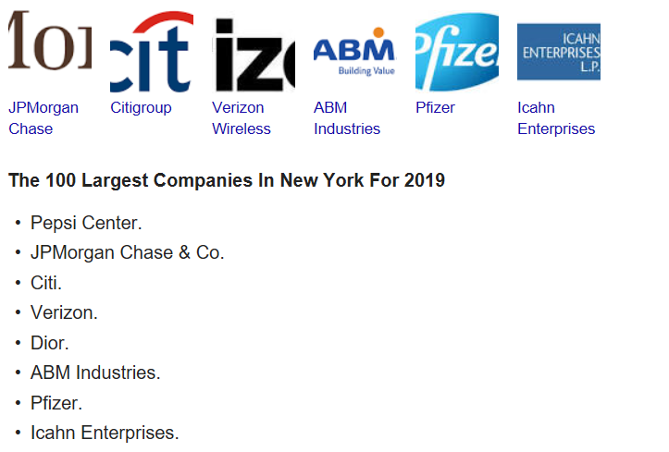
New York City – Business
NYC is considered heart of the business world.
The city is designed for competition.
The ability to recruit top talent in the city.
New businesses should analyze the risk vs reward.

Slide 6
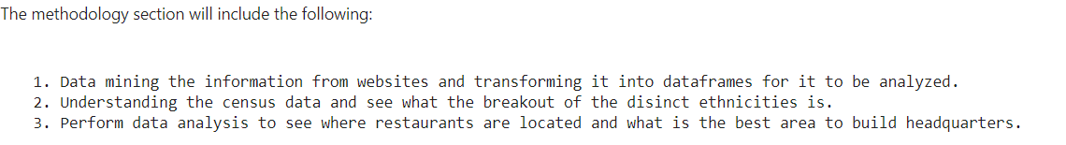
Methodology

Slide 7
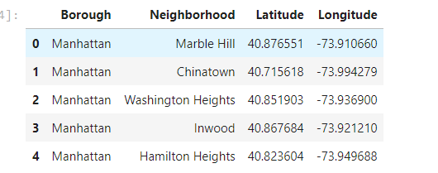
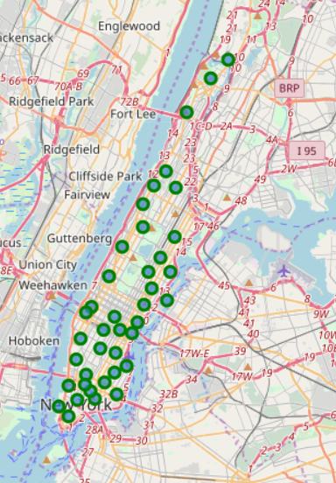
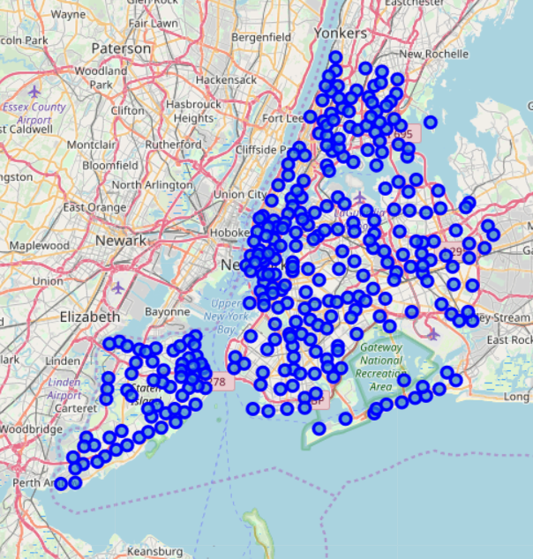
Data
The first data set was to go over the neighborhoods that were located in Manhattan.
To see where all the neighborhoods of New York are located.
Client’s requirement is look for a place in Manhattan.
The Green dots are all the neighborhoods located in Manhattan.

Slide 8
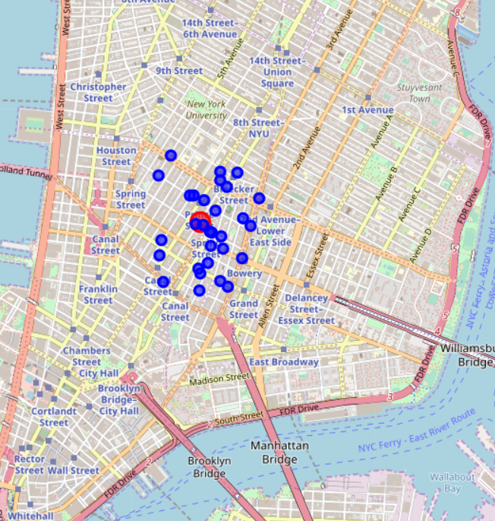
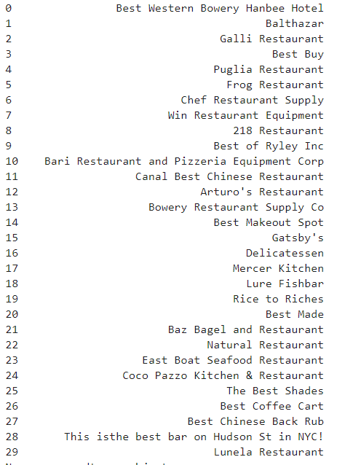
Sample of Entertainment Spots

Slide 9
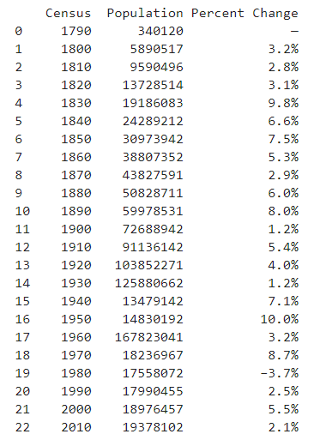
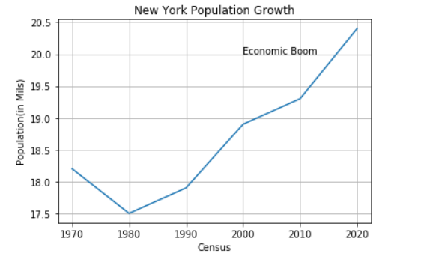
Population Data
NYC population is has been growing at an average of 3%.
This population also is where the top talent is coming from for the big companies.

Slide 10
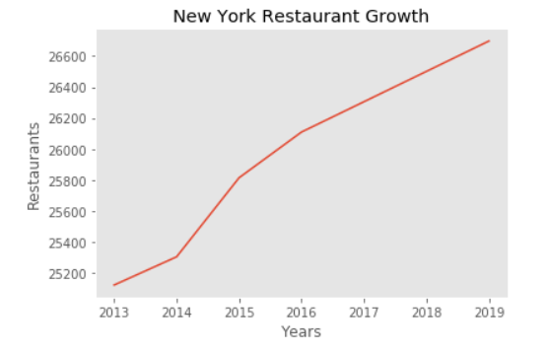
Restaurant Growth for NYC
New York on average is growing by 500 restaurants per year.
It is currently sitting at 26,400 restaurants for 2019.

Slide 11
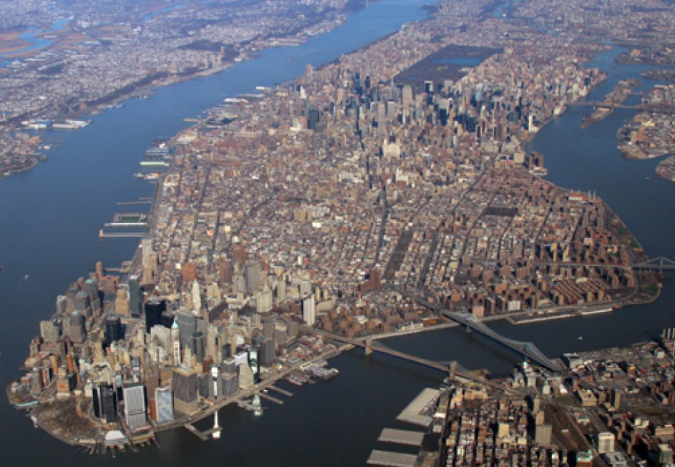
Discussion
Manhattan spots many different types of cuisines. It is a perfect place for multinational firm to set up headquarters.
The price may be expensive but it is worth the investment since companies tend to attract top talent.
Our analysis is based on current data and there might be limitations in our recommendation.
Our conclusion might get updated due to update in data.
Manhattan does offer cuisines & entertainment from Indian, Chinese, American, Pakistan, Middle eastern, African and many more.
The cost to set up shop in NYC will get more expensive as time goes on and that is the risk analysis a company has to do.

